Slide 1

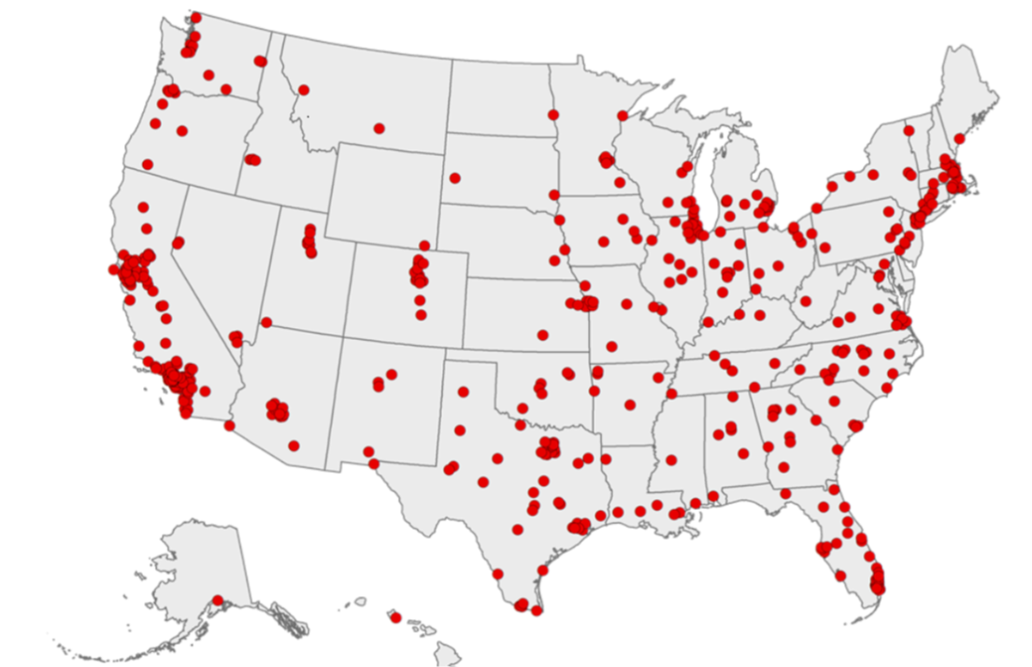

Metropolitan Health:
500 U.S. Cities
Douglas Franklin, Hisham Hammour, Mason Carnahan, Muhammad Ahsan

Slide 2
Motivation
Health
*Pertinent to all
*Bankruptcy
Community Matters
*Access
*Quality

Slide 3
What we asked. Why we asked.
Which state has the healthiest cities?
  Assumption: California
What about the least healthy?
  Assumption: Mississippi
Does preventative mean healthy?
  Assumtion: Yes
Do unhealthy behaviors mean disease?
  Assumption: Yes
We are all in the US job market
  Moving
We all think about health at some point
  Age
It is a challenge
"The city is the teacher of the man."
--Simonides

Slide 4
Answering health questions:
Satisfaction..
Health is hard.
Correlation trouble
Causation?

Slide 5

Data source & Contents
Source
  Data.gov
  Dataset includes
    2015 - 2016
    26 measures of chronic disease
    Unhealthy behaviors, use of preventive services, health outcomes
Data were provided by
  Centers for Disease Control and Prevention (CDC)
  Division of Population Health
  Epidemiology and Surveillance Branch.

Slide 6
Data Cleanup & Exploration
800,000 rows, 24columns, a lot of problems
  Git limits
  Dropping redundancies
    Columns
    Means
    Know your data..
    800,000 x 23 → 14,000 x 13
How to tell a story across all of this?

Slide 7
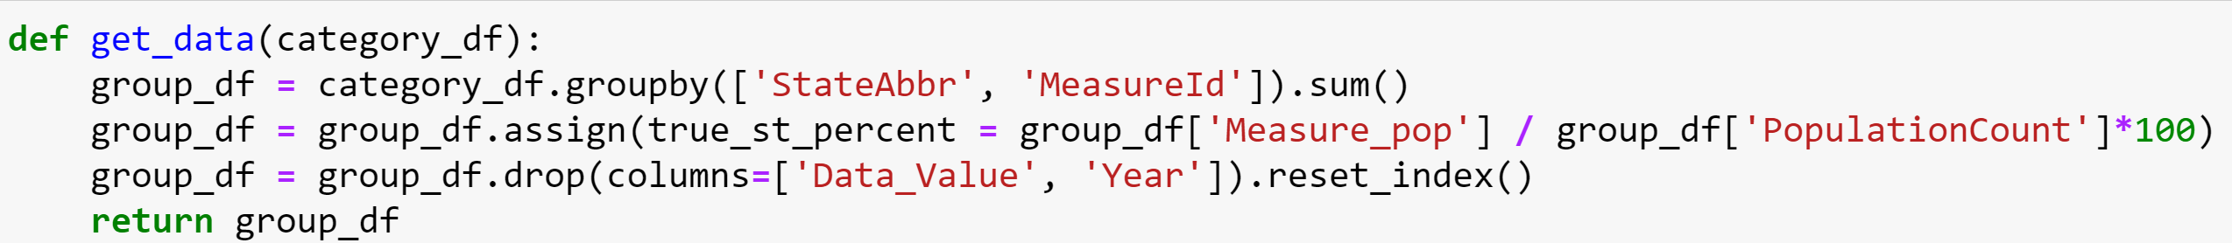
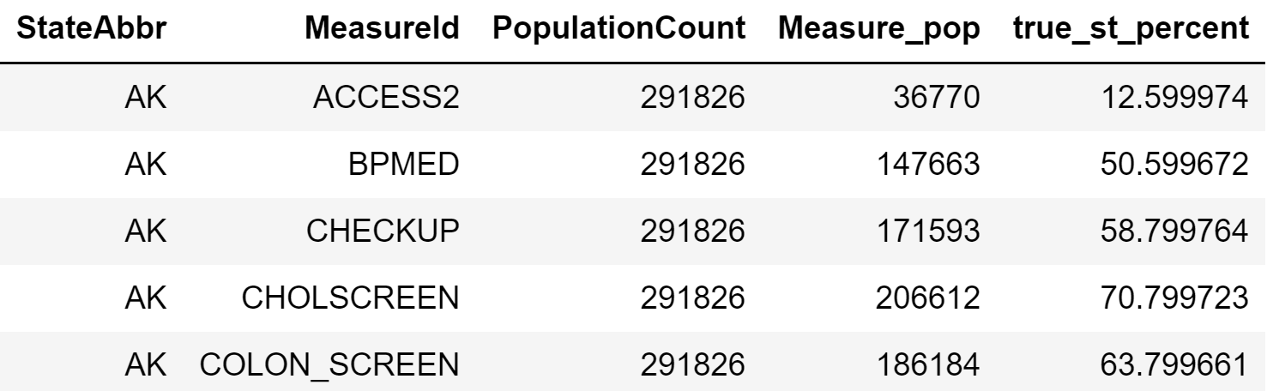
Data Munging: an attempt at meaningfulness
Not all percents are created equal
  Groupby problems
    #Know your data
    Pandas is awesome

Slide 8
Data Analysis
How to compare 26 measures for 50 states?
Ranking
*Categories
*Metaranking
*True ranking

Slide 9
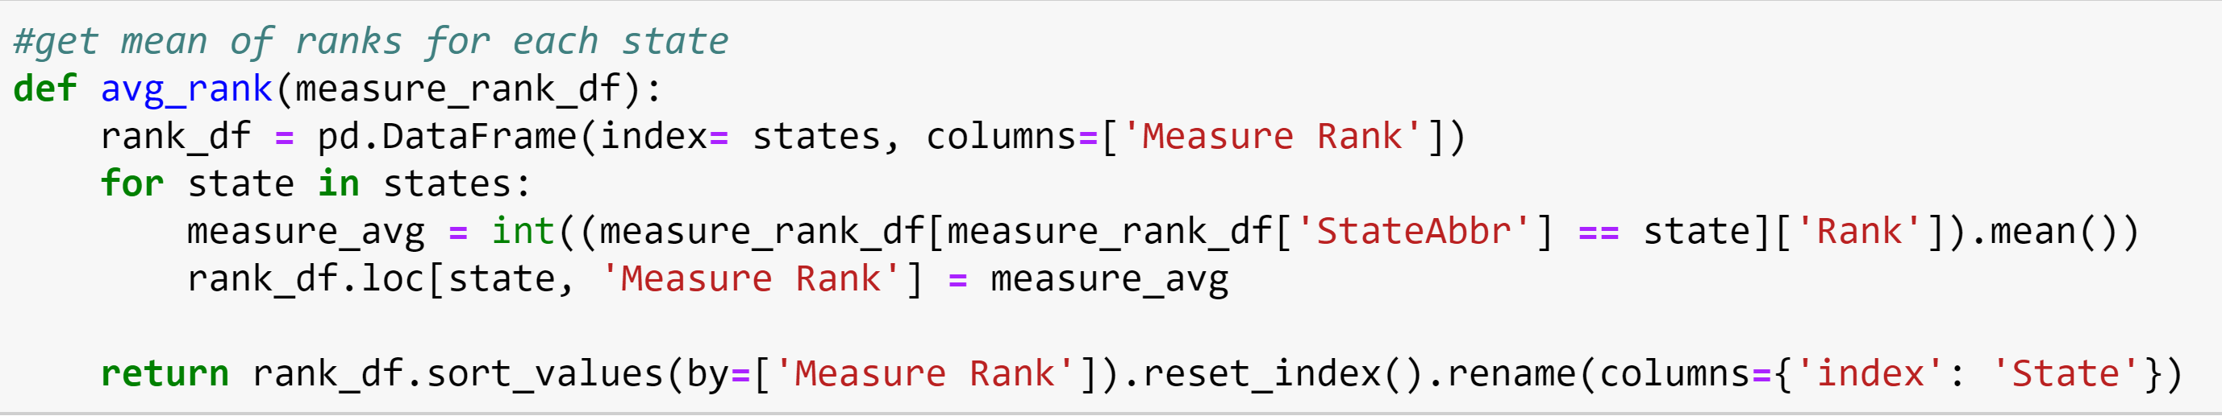
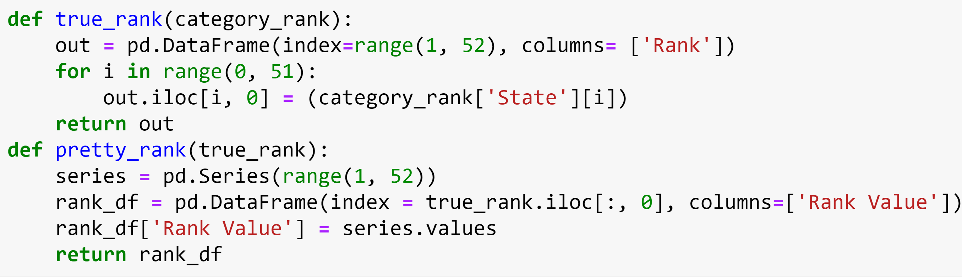
Data Functions: reduction of workload?
Methods of Ranking
    Functions are powerful
Cleaning the Ranking

Slide 10
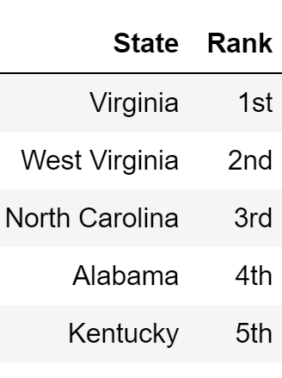
Conclusions: States taking preventative measures
Preventative Behaviors
Yearly Doctor & Dentist checkups
Taking BP medication for high BP
Use of Various clinical services
  Cholesterol screenings
  Pap smears
  Colonoscopies
Men and women >=65 up to date on clinical services
  Vaccinations
  Colon screenings
  mammograms

Slide 11
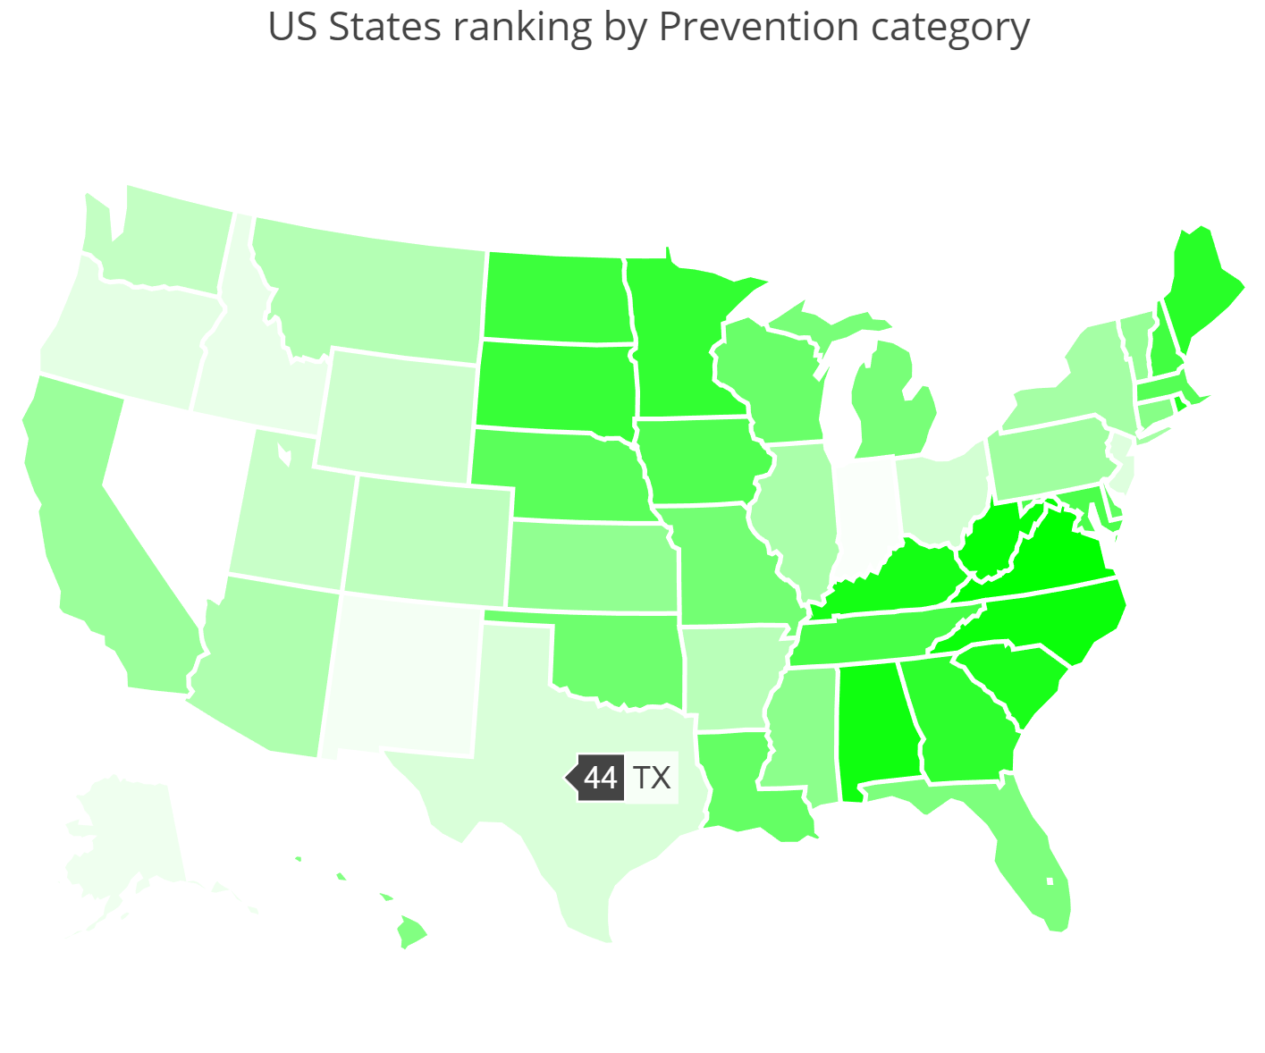
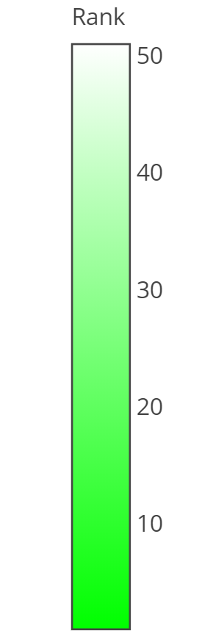
States taking preventative measures
Texas could use some work
The Virginias are killing it
What does this mean?
Initial thinking vs later thinking
51
32
2
1
CDC
29

Slide 12
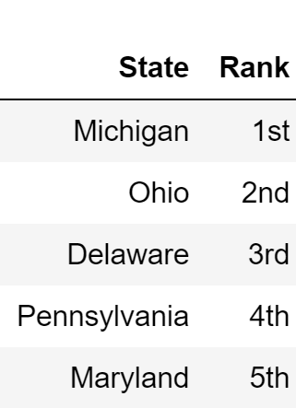
Conclusions: Unhealthy States
Unhealthy Behaviors
Binge drinking
Cigarette smoking
No leisure-time physical activity
Obesity among
Sleeping less than 7 hours

Slide 13
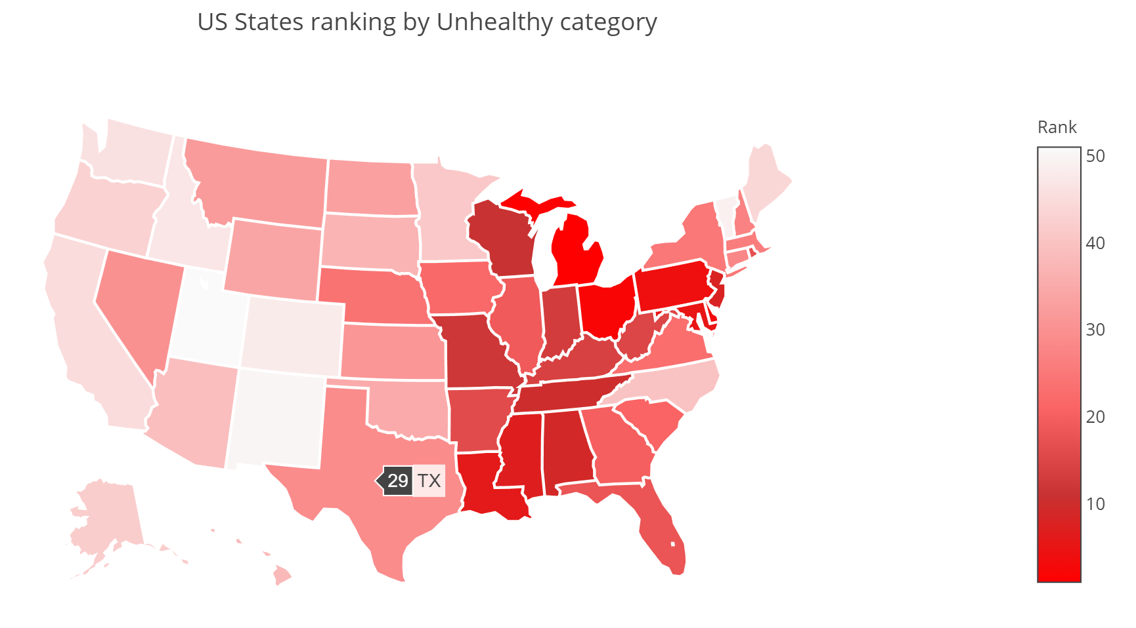
Unhealthy Behaviors
Sorry MI, we were wrong about you(kinda)
Go Utah!
Texas, meh
1
45
51
7

Slide 14
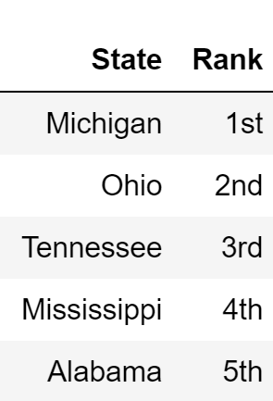
Who has the most disease? who
Measured by
Disease states
Cancer
Coronary heart disease
Diabetes
COPD
Kidney disease
Arthritis
& Disease indicators
High cholesterol
High blood pressure
Stroke
All teeth lost for age >=65
Poor physical health >= 2 weeks
Poor mental health >= 2 weeks

Slide 15
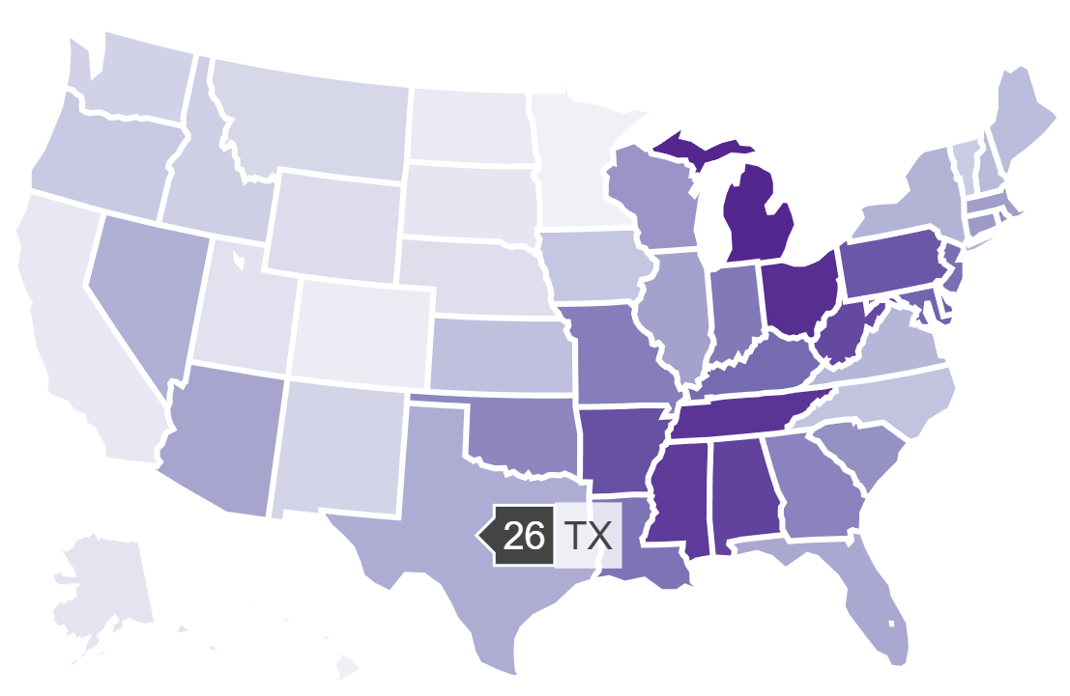
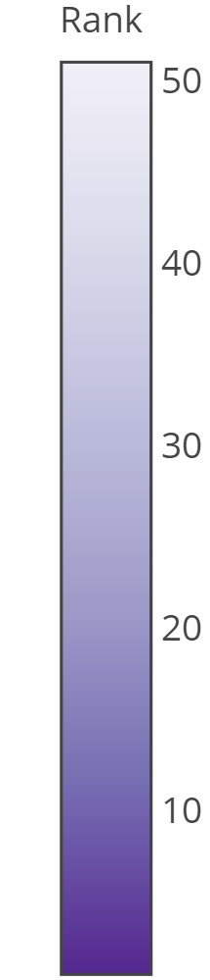
Who has the most disease?
Michigan!
  Flint?
Mississippi, ouch
California, good weather = good health?
51
1
47
4

Slide 16
Discussion & Post-Mortem
What we expected
Sorry Mississippi, it was Michigan
California? Nope, Virginia
Initial expectations are often wrong
Biases
Health is hard, so are groups.
Roles & delegation
Correltion maybe, Causation HA!

Slide 17
Post Mortem
Difficulties
  Git problems
  New data scientist problems
  Big goals
    Interactive plotly down to districts
Questions Unanswered
  What are the death rates by disease?
  Does incidence show a correlation with death?
  What does this tell us about access, quality, and or culture?

Slide 18
Thank you! → Q & A
Thank you : Trilogy Education
special_thanks_to =
[
Ed, Dylan, and Ryan,
Stack Overflow, Jupyter notebooks, matplotlib, plotly
Various Documentations
Government collected opensource data
Civil classmates
]

